Slide 1
Data Analytics – Lesson 12 Generalized Linear Models (GLM) and Ordinary Least Squares (OLS)
Jeffrey Strickland, Ph.D., CMSP, ASEP
CEO Humalytica Analytics

Slide 2
Ordinary Least Squares (OLS)
In statistics, ordinary least squares (OLS) or linear least squares is a method for estimating the unknown parameters in a linear regression model.
This method minimizes the sum of squared vertical distances between the observed responses in the dataset and the responses predicted by the linear approximation.
The resulting estimator can be expressed by a simple formula, especially in the case of a single regressor on the right-hand side.
OLS estimator Condition | Errors (Residuals)
OLS estimator is consistent | exogenous and there is no perfect multicollinearity
OLS estimator is optimal | homoscedastic and serially uncorrelated
provides minimum-variance mean-unbiased estimatio | finite variances
maximum likelihood estimator | normally distributed

Slide 3
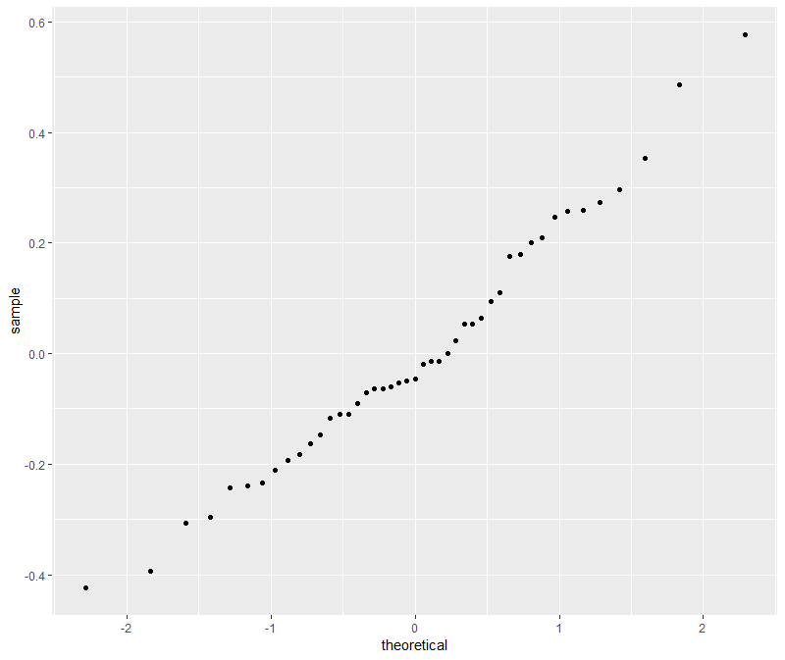
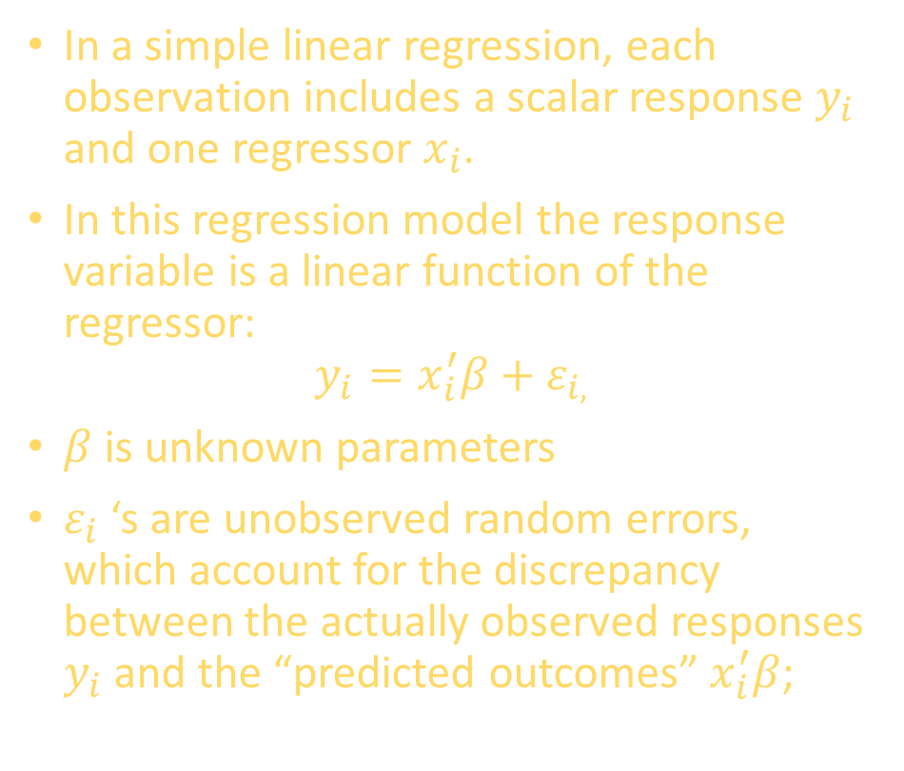
Considerations
In a simple linear regression, each observation includes a scalar response $y_{i}$ and one regressor $x_{i}$.
In this regression model the response variable is a linear function of the regressor:
$$y_{i}=x_{i}^{′}β+ε_{i,}$$
$β$ is unknown parameters
$ε_{i}$ ‘s are unobserved random errors, which account for the discrepancy between the actually observed responses $y_{i}$ and the “predicted outcomes” $x_{i}^{′}β$;
minimizes the sum of squared vertical distances between the observed responses in the dataset and the responses predicted by the linear approximation
…
…
+
+
…
+
…
+
…
+
…
+
…
+
+

Slide 4

Considerations
Suppose the data consists of $n$ observations ${\{y_{i},x_{i}\}}_{i=1}^{n}$.
Each observation includes a scalar response $y_{i}$ and a vector of $p$ predictors (or regressors) $x_{i}$.
In a linear regression model the response variable is a linear function of the regressors:
$$y_{i}=x_{i}^{′}β+ε_{i,}$$
$β$ is a $p×1$ vector of unknown parameters
$ε_{i}$ ‘s are unobserved random errors, which account for the discrepancy between the actually observed responses $y_{i}$ and the “predicted outcomes” $x_{i}^{′}β$;

Slide 5

Considerations
A$lso x′$ denotes matrix transpose, so that $x′β$ is the dot product between the vectors $x$ and $β$.
This model can also be written in matrix notation as
$$y=Xβ+ε,$$
$y$ and $ε$ are $n×1$ vectors
$X$ is an $n×p$ matrix of regressors, which is also sometimes called the design matrix.
Example coefficient matrix:
$$β =\left[\begin{matrix}b_{11} & ⋯ & b_{1n} \\ ⋮ & ⋱ & ⋮ \\ b_{n1} & ⋯ & b_{nn}\end{matrix}\right]$$

Slide 6

OLS Example – Galapagos Islands
Now let’s look at an example concerning the number of species of tortoise on the various Galapagos Islands. There are 30 cases (Islands) and 7 variables in the dataset.

Slide 7

OLS Example – Galapagos Islands
gala <- read.csv("C:/Users/Strickland/Documents/VIT University/gala.csv")
data(gala)
Gala
Scruz = distance from Santa Cruz island (km)
Island Species Endemics Area Elevation Nearest Scruz Adjacent
1 Baltra 58 23 25.09 346 0.6 0.6 1.84
2 Bartolome 31 21 1.24 109 0.6 26.3 572.33
3 Caldwell 3 3 0.21 114 2.8 58.7 0.78
4 Champion 25 9 0.10 46 1.9 47.4 0.18
5 Coamano 2 1 0.05 77 1.9 1.9 903.82
6 Daphne.Major 18 11 0.34 119 8.0 8.0 1.84
$⋮$ $⋮$ $⋮$ $⋮$ $⋮$ $⋮$ $⋮$ $⋮$
29 Tortuga 16 8 1.24 186 6.8 50.9 17.95
30 Wolf 21 12 2.85 253 34.1 254.7 2.33

Slide 8

Three Model Comparison
First, we generate a series of plots of various species-area relations. We consider three models: Linear, Gleason, and log-Arrhenius.
1. Linear model:
$S\sim \text{Normal}(μ,σ^{2})$ with identity link such that $μ=β_{0}+β_{1}A$.
2. Gleason model:
$S\sim \text{Normal}(μ,σ^{2})$ with identity link such that $μ=β_{0}+β_{1}\text{log}A$.
3. log-Arrhenius model:
$S\sim \text{Normal}(μ,σ^{2})$ with identity link such that $μ=β_{0}A^{β_{1}}$.

Slide 9
Model 1 – Linear
model1<-lm(Species~Area,data=gala)
logLik(model1)
AIC(model1)
'log Lik.' -177.0992664 (df=3)
[1] 360.1985328

Slide 10
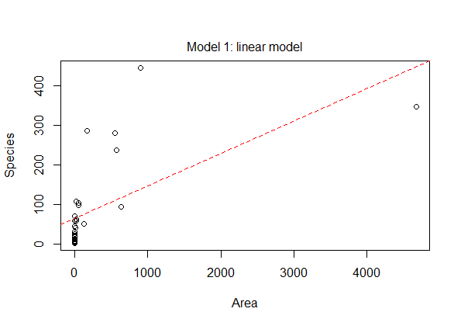
Model 1 Plot
plot(gala$Area,gala$Species, xlab='Area', ylab='Species')
abline(model1,col=2, lty=2)
mtext('Model 1: linear model', side=3, line=.5)

Slide 11
Model 2 - Gleason
model2<-lm(Species~log(Area),data=gala)
logLik(model2)
AIC(model2)
'log Lik.' -169.9573668 (df=3)
[1] 345.9147336

Slide 12
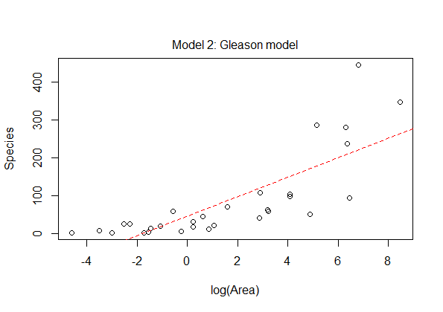
Model 2 Plot
plot(log(gala$Area), gala$Species, xlab='log(Area)', ylab='Species')
abline(model2,col=2,lty=2)
mtext( ‘Model 2: Gleason model‘, side=3, line=.5)

Slide 13
Model 3 – log-Arrhenius
model3<-lm(log(Species)~log(Area), data=gala)
logLik(model3)
AIC(model3)
'log Lik.' -34.23972758 (df=3)
[1] 74.47945516

Slide 14
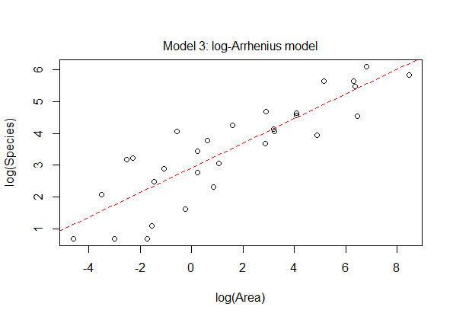
Model 3 Plot
plot(log(gala$Area), log(gala$Species), xlab='log(Area)', ylab='log(Species)')
abline(model3,col=2,lty=2)
mtext('Model 3: log-Arrhenius model', side=3, line=.5)
model.names<-c('Linear', 'Gleason', 'Log-Arrhenius')
loglike <-c(logLik(model1),logLik(model2),logLik(model3))
numparms<-c(3,3,3)

Slide 15
Define Akaike information criterion (AIC)
AIC.func<-function(LL,K,n,modelnames)
{
AIC<- -2*LL + 2*K
AICc<-AIC + 2*K*(K+1)/(n-K-1)
output<-cbind(LL,K,AIC,AICc)
colnames(output)<-c('LogL','K','AIC','AICc')
minAICc<-min(output[,"AICc"])
deltai<-output[,"AICc"]-minAICc
rel.like<-exp(-deltai/2)
wi<-round(rel.like/sum(rel.like),3)
out<-data.frame(modelnames,output,deltai,wi)
out
}
AIC.func(loglike,numparms,dim(gala)[1],model.names)

Slide 16
Define Akaike information criterion (AIC)
modelnames LogL K AIC AICc deltai wi
1 Linear -177.09926639 3 360.19853279 361.12160971 285.7190776 0
2 Gleason -169.95736682 3 345.91473365 346.83781057 271.4352785 0
3 Log-Arrhenius -34.23972758 3 74.47945516 75.40253209 0.0000000 1

Slide 17

OLS Example – Galapagos Islands Part 2
The previous models only examine the Species-Area relationship. We now consider additional variables: Endemics, Elevation, Nearest, Scruz, and Adjacent. We will call our model gfit.

Slide 18
Add Variables
gfit <- lm(Species~Area + Elevation + Nearest + Scruz + Adjacent, data=gala)
summary(gfit)
Call:
lm(formula = Species ~ Area + Elevation + Nearest + Scruz + Adjacent,
data = gala)
Coefficients:
Estimate Std. Error t value Pr(>|t|)
(Intercept) 7.068220709 19.154197824 0.36902 0.71535080
Area -0.023938338 0.022422351 -1.06761 0.29631799
Elevation 0.319464761 0.053662804 5.95319 0.0000038234 ***
Nearest 0.009143961 1.054135949 0.00867 0.99315065
Scruz -0.240524230 0.215402248 -1.11663 0.27520822
Adjacent -0.074804832 0.017700188 -4.22622 0.00029707 ***
---
Signif. codes: 0 ‘***’ 0.001 ‘**’ 0.01 ‘*’ 0.05 ‘.’ 0.1 ‘ ’ 1
Residual standard error: 60.97519 on 24 degrees of freedom
Multiple R-squared: 0.7658469, Adjusted R-squared: 0.7170651
F-statistic: 15.69941 on 5 and 24 DF, p-value: 0.0000006837893

Slide 19
Fit a Linear Model
lm(formula = Species~Area + Elevation + Nearest + Scruz + Adjacent, data=gala)
Call:
lm(formula = Species ~ Area + Elevation + Nearest + Scruz + Adjacent,
data = gala)
Coefficients:
(Intercept) Area Elevation Nearest Scruz Adjacent
7.068220709 -0.023938338 0.319464761 0.009143961 -0.240524230 -0.074804832

Slide 20
Summarize the Model
summary(gfit)
Call:
lm(formula = Species ~ Area + Elevation + Nearest + Scruz + Adjacent,
data = gala)
Coefficients:
Estimate Std. Error t value Pr(>|t|)
(Intercept) 7.068220709 19.154197824 0.36902 0.71535080
Area -0.023938338 0.022422351 -1.06761 0.29631799
Elevation 0.319464761 0.053662804 5.95319 0.0000038234 ***
Nearest 0.009143961 1.054135949 0.00867 0.99315065
Scruz -0.240524230 0.215402248 -1.11663 0.27520822
Adjacent -0.074804832 0.017700188 -4.22622 0.00029707 ***
---
Signif. codes: 0 ‘***’ 0.001 ‘**’ 0.01 ‘*’ 0.05 ‘.’ 0.1 ‘ ’ 1
Residual standard error: 60.97519 on 24 degrees of freedom
Multiple R-squared: 0.7658469, Adjusted R-squared: 0.7170651
F-statistic: 15.69941 on 5 and 24 DF, p-value: 0.0000006837893

Slide 21
Generalized Linear Models (GLM)
The generalized linear model (GLM) is a flexible generalization of ordinary linear regression that allows for response variables that have error distribution models other than a normal distribution.
The GLM generalizes linear regression by allowing the linear model to be related to the response variable via a link function and by allowing the magnitude of the variance of each measurement to be a function of its predicted value.
Example:
Data on 150 rats contain identifying “litter”, “rx” (indicator of injection of drug after initial administration of carcinogen), time in days on study (ignored initially, and “status” which is indicator of tumor, our binary response variable.

Slide 22
Considerations
Ordinary linear regression predicts the expected value of a given unknown quantity (the response variable) as a linear combination of a set of observed values (predictors).
This implies that a constant change in a predictor leads to a constant change in the response variable—a linear-response model
This is appropriate when the response variable has a normal distribution
Intuitively, this occurs when a response variable can vary essentially indefinitely in either direction with no fixed “zero value”
These assumptions are inappropriate for many types of response variables.
For example, in many cases when the response variable must be positive and can vary over a wide scale, constant input changes lead to geometrically varying rather than constantly varying output changes.
As an example, a model that predicts that each decrease in 10 degrees Fahrenheit leads to 1,000 fewer people going to a given beach is unlikely to generalize well over both small beaches and large beaches
Similarly, a model that predicts a probability of making a yes/no choice is even less suitable as a linear-response model, since probabilities are bounded on both ends (they must be between 0 and 1).

Slide 23

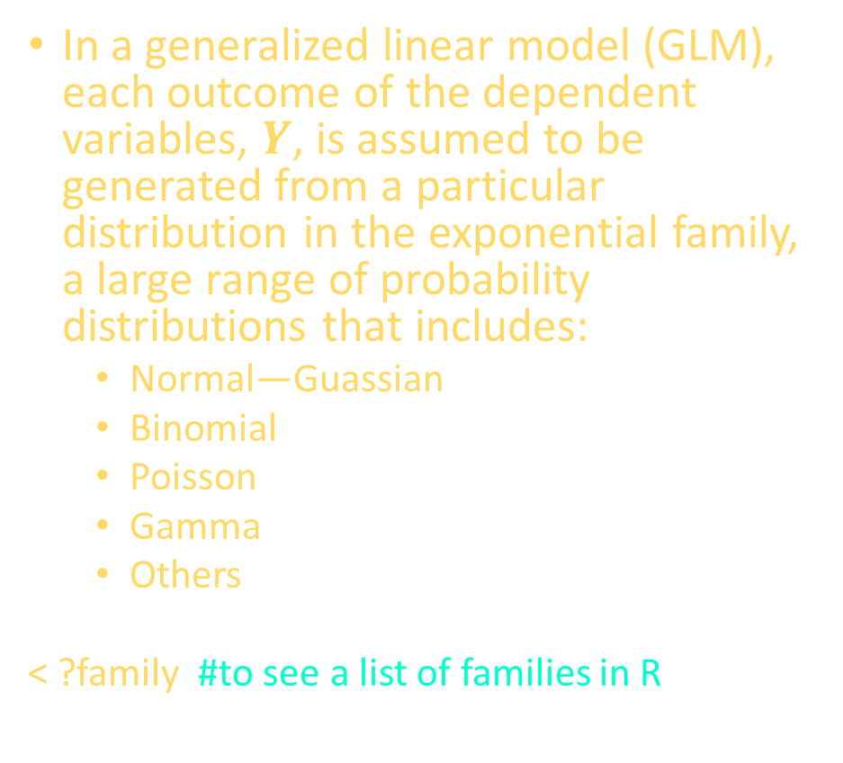
Overview
In a generalized linear model (GLM), each outcome of the dependent variables, $Y$, is assumed to be generated from a particular distribution in the exponential family, a large range of probability distributions that includes:
Normal—Guassian
Binomial
Poisson
Gamma
Others
< ?family #to see a list of families in R
. The mean, $μ$, of the distribution depends on the independent variables, $X$, through:
$$E\left(Y\right)=μ=g^{−1}\left(Xβ\right),$$
$E(Y)$ is the expected value of $Y$
$Xβ$ is the linear predictor, a linear combination of unknown parameters, $β$
$g$ is the link function
In this framework, the variance is typically a function, $V$, of the mean:
$$\text{Var}\left(Y\right)=V\left(μ\right)=V\left(g^{−1}\left(Xβ\right)\right).$$

Slide 24
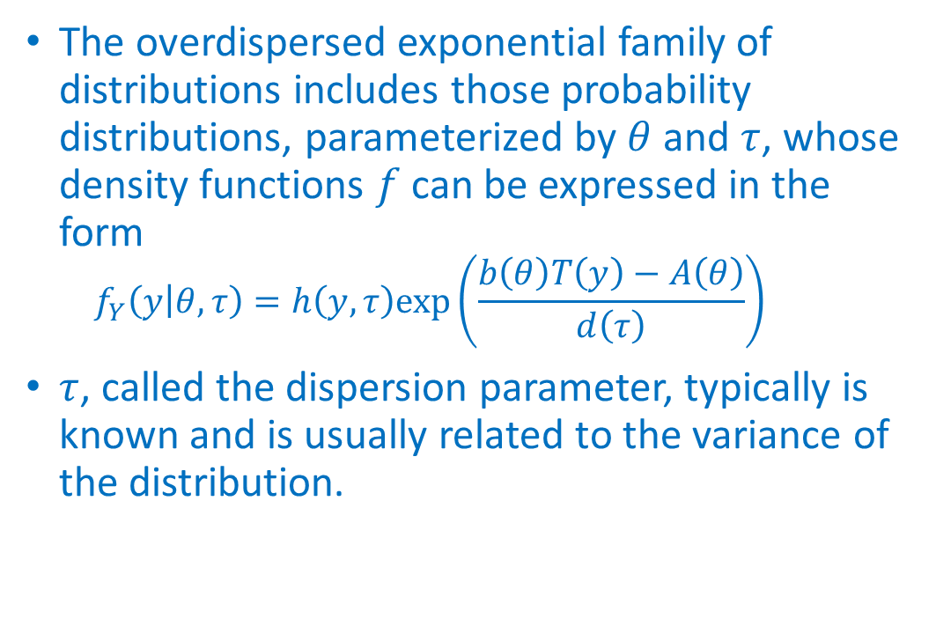
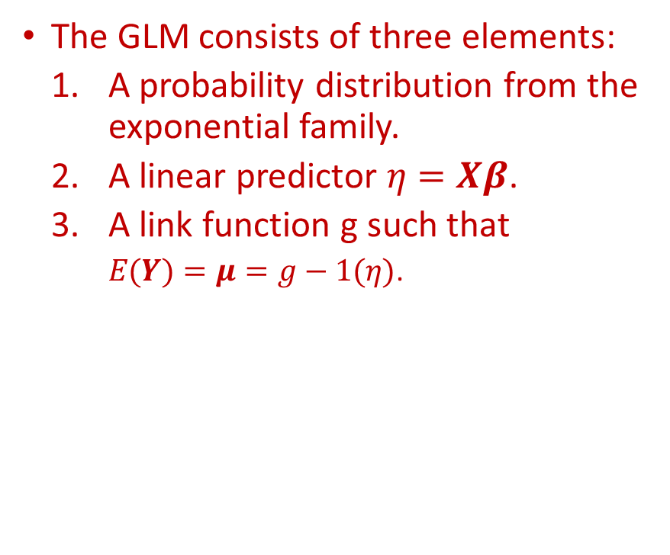
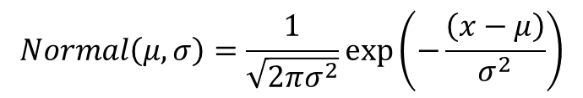
Model Components
The GLM consists of three elements:
A probability distribution from the exponential family.
A linear predictor $η=Xβ$.
A link function g such that
$E(Y)=μ=g−1(η)$.
The overdispersed exponential family of distributions includes those probability distributions, parameterized by $θ$ and $τ$, whose density functions $f$ can be expressed in the form
$$f_{Y}\left(y | θ,τ\right)=h\left(y,τ\right)\text{exp}\left(\frac{b\left(θ\right)T\left(y\right)−A\left(θ\right)}{d\left(τ\right)}\right)$$
$τ$, called the dispersion parameter, typically is known and is usually related to the variance of the distribution.
$$Normal\left(μ,σ\right)=\frac{1}{\sqrt{2πσ^{2}}}\text{exp}\left(−\frac{\left(x−μ\right)}{σ^{2}}\right)$$

Slide 25
Example – Rats! – Four Models
library(survival)
summary(rats)
litter rx time status
Min. : 1.0 Min. :0.0000 Min. : 34.00 Min. :0.0000
1st Qu.:13.0 1st Qu.:0.0000 1st Qu.: 78.25 1st Qu.:0.0000
Median :25.5 Median :0.0000 Median : 94.50 Median :0.0000
Mean :25.5 Mean :0.3333 Mean : 89.43 Mean :0.2667
3rd Qu.:38.0 3rd Qu.:1.0000 3rd Qu.:104.00 3rd Qu.:1.0000
Max. :50.0 Max. :1.0000 Max. :104.00 Max. :1.0000

Slide 26
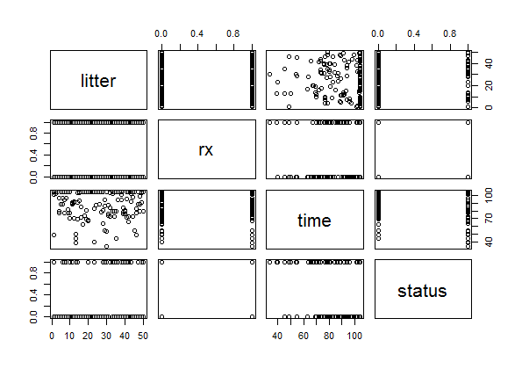
Plot - Rats
plot(rats)

Slide 27
Rats Model 1
fitB1 = glm(cbind(status,1-status) ~ rx, family=binomial, data = rats)
fitB1
Call: glm(formula = cbind(status, 1 - status) ~ rx, family = binomial,
data = rats)
Coefficients:
(Intercept) rx
-1.450 1.127
Degrees of Freedom: 149 Total (i.e. Null); 148 Residual
Null Deviance: 174
Residual Deviance: 165.3 AIC: 169.3

Slide 28
Summary of Rats Model 1
summary(fitB1)$coef
Estimate Std. Error z value Pr(>|z|)
(Intercept) -1.450010 0.2549063 -5.688404 1.282324e-08
rx 1.127237 0.3835089 2.939272 3.289845e-03

Slide 29
Standard Error of Rats Model 1
sqrt(diag(summary(fitB1)$cov.scaled))
c(fitB1$deviance, -2*logLik(fitB1))
c(fitB1$null.dev, -2*logLik(update(fitB1, formula = .~ 1)))
(Intercept) rx
0.2549063 0.3835089
[1] 165.2738 165.2738
[1] 173.9746 173.9746

Slide 30
Rats Model 2
fitB2 = update(fitB1, family=binomial(link="probit"))
rbind(logit= fitB1$coef, probit= fitB2$coef, rescal.probit = fitB2$coef/0.5513)
(Intercept) rx
logit -1.4500102 1.1272368
probit -0.8778963 0.6760028
rescal.probit -1.5924112 1.2261977

Slide 31
Rats Model 3
fitB3 = update(fitB1, formula= . ~ . + I(log(time)))
summary(rats$time[rats$status==1])
Min. 1st Qu. Median Mean 3rd Qu. Max.
34.00 66.75 80.00 77.28 92.50 104.00

Slide 32
Rats Model 3 - Time
cbind(rats[1:10,], model.matrix(fitB3)[1:10,])
litter rx time status (Intercept) rx I(log(time))
1 1 1 101 0 1 1 4.615121
2 1 0 49 1 1 0 3.891820
3 1 0 104 0 1 0 4.644391
4 2 1 104 0 1 1 4.644391
5 2 0 102 0 1 0 4.624973
6 2 0 104 0 1 0 4.644391
7 3 1 104 0 1 1 4.644391
8 3 0 104 0 1 0 4.644391
9 3 0 104 0 1 0 4.644391
10 4 1 77 0 1 1 4.343805

Slide 33
Rats Model 3 Standard Error
summary(fitB3)$coef
Estimate Std. Error z value Pr(>|z|)
(Intercept) 17.868661 4.4924813 3.977459 6.965559e-05
rx 1.194019 0.4284626 2.786751 5.323935e-03
I(log(time)) -4.355407 1.0180848 -4.278040 1.885462e-05

Slide 34
Rats Model 3 Log Likelihood
c(2*(logLik(fitB3)-logLik(fitB1)), fitB1$dev-fitB3$dev)
1-pchisq(24.373,1)
[1] 24.37307 24.37307
[1] 7.937339e-07

Slide 35
Rats Model 4
fitB4 = update(fitB3, .~. + I(rx*log(time)) + I(log(time)^2))
summary(fitB4)$coef
Estimate Std. Error z value Pr(>|z|)
(Intercept) -9.784968 52.690740 -0.1857056 0.85267560
rx -13.501206 8.732837 -1.5460274 0.12209794
I(log(time)) 10.179730 24.364938 0.4178024 0.67609159
I(rx * log(time)) 3.324780 1.973389 1.6848069 0.09202582
I(log(time)^2) -1.871215 2.819823 -0.6635932 0.50695069

Slide 36
Rats Models 3 and 4 Difference
fitB3$dev - fitB4$dev
[1] 3.901065

Slide 37
Rats Model 4 ANOVA
anova(fitB4)
Analysis of Deviance Table
Model: binomial, link: logit
Response: cbind(status, 1 - status)
Terms added sequentially (first to last)
Df Deviance Resid. Df Resid. Dev
NULL 149 173.97
rx 1 8.7008 148 165.27
I(log(time)) 1 24.3731 147 140.90
I(rx * log(time)) 1 3.4784 146 137.42
I(log(time)^2) 1 0.4226 145 137.00

Slide 38
Rats Models 3 and 4 Deviance
Devs = c(fitB1$null.dev, fitB1$dev, fitB3$dev, update(fitB3, .~.+I(rx*log(time)))$dev, fitB4$dev)
Devs
[1] 173.9746 165.2738 140.9007 137.4223 136.9997

Slide 39
Rounded Deviance
round (-diff(Devs), 3 )### successive differences of llks
[1] 8.701 24.373 3.478 0.423

Slide 40
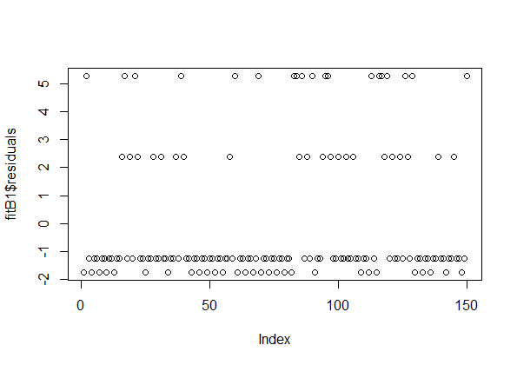
Rats Model 1 Plot
plot(fitB1$residuals)

Slide 41
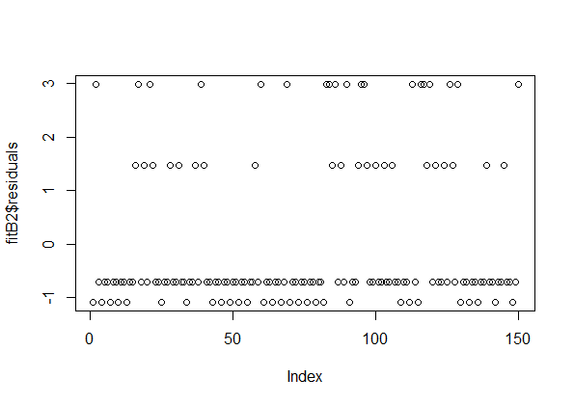
Rats Model 2 Plot
plot(fitB2$residuals)

Slide 42
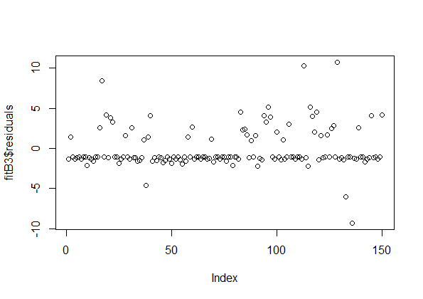
Rats Model 3 Plot
plot(fitB3$residuals)

Slide 43
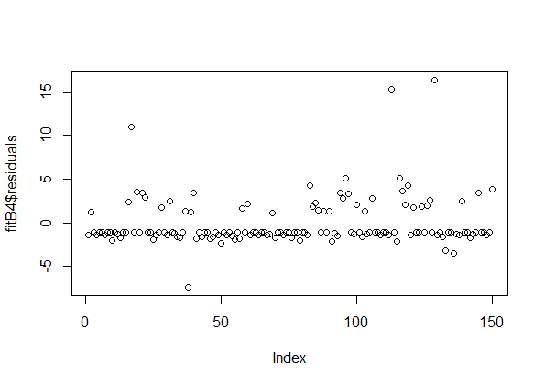
Rats Model 4 Plot
plot(fitB4$residuals)

Slide 44
Example 2
In Example 1, we looked at two basic type of GLMs, binomial (logit) and binomial (probit).
Both of these were in the binomial distribution family according to the type of response variable. We now considered other types of GLMs and compare them accordingly.
Using the Longley dataset, a macroeconomic data set which provides a well-known example for a highly collinear regression.
A data frame with 7 economic variables, observed yearly from 1947 to 1962 (n=16).
GNP.deflator: GNP implicit price deflator (1954=100)
GNP: Gross National Product
Unemployed: number of unemployed
Armed.Forces: number of people in the armed forces
Population: ‘noninstitutionalized’ population ≥ 14 years of age
Year: the year (time)
Employed: number of people employed

Slide 45
Longley Model
require(stats); require(graphics)
longley.x <- data.matrix(longley[, 1:6])
summary(longley.x)
GNP.deflator GNP Unemployed Armed.Forces
Min. : 83.00 Min. :234.3 Min. :187.0 Min. :145.6
1st Qu.: 94.53 1st Qu.:317.9 1st Qu.:234.8 1st Qu.:229.8
Median :100.60 Median :381.4 Median :314.4 Median :271.8
Mean :101.68 Mean :387.7 Mean :319.3 Mean :260.7
3rd Qu.:111.25 3rd Qu.:454.1 3rd Qu.:384.2 3rd Qu.:306.1
Max. :116.90 Max. :554.9 Max. :480.6 Max. :359.4
Population Year
Min. :107.6 Min. :1947
1st Qu.:111.8 1st Qu.:1951
Median :116.8 Median :1954
Mean :117.4 Mean :1954
3rd Qu.:122.3 3rd Qu.:1958
Max. :130.1 Max. :1962

Slide 46
Longley Model
longley.y <- longley[, "Employed"]
pairs(longley, main = "longley data")
longley.mod1<-glm(Employed ~ .,data=longley,family=gaussian(identity))
summary(longley.mod1)
Call:
glm(formula = Employed ~ ., family = gaussian(identity), data = longley)
Estimate Std. Error t value Pr(>|t|)
(Intercept) -3.482e+03 8.904e+02 -3.911 0.003560 **
GNP.deflator 1.506e-02 8.492e-02 0.177 0.863141
GNP -3.582e-02 3.349e-02 -1.070 0.312681
Unemployed -2.020e-02 4.884e-03 -4.136 0.002535 **
Armed.Forces -1.033e-02 2.143e-03 -4.822 0.000944 ***
Population -5.110e-02 2.261e-01 -0.226 0.826212
Year 1.829e+00 4.555e-01 4.016 0.003037 **
---
Signif. codes: 0 ‘***’ 0.001 ‘**’ 0.01 ‘*’ 0.05 ‘.’ 0.1 ‘ ’ 1
(Dispersion parameter for gaussian family taken to be 0.09293601)
Null deviance: 185.00883 on 15 degrees of freedom
Residual deviance: 0.83642 on 9 degrees of freedom
AIC: 14.187
Number of Fisher Scoring iterations: 2

Slide 47
Longley Model
longley.mod1<-glm(formula = Employed ~ ., family = Gamma(inverse), data = longley)
longley.mod2<-glm(formula = Employed ~ ., family = gaussian(identity), data = longley)
longley.mod3<-glm(formula = Employed ~ ., family = poisson(log), data = longley)
longley.mod4<-glm(formula = Employed ~ ., family = inverse.gaussian, data = longley)
rbind(Gamma= longley.mod1$coef, gaussian= longley.mod2$coef, poisson=longley.mod3$coeff, inverse.gaussian=longley.mod4$coef)
(Intercept) GNP.deflator GNP Unemployed
Gamma 9.216863e-01 -7.325451e-06 9.297934e-06 4.783348e-06
gaussian -3.482259e+03 1.506187e-02 -3.581918e-02 -2.020230e-02
poisson -5.262691e+01 3.570455e-04 -5.788587e-04 -3.111645e-04
inverse.gaussian 2.907252e-02 -2.786624e-07 2.971755e-07 1.468006e-07
Armed.Forces Population Year
Gamma 2.126791e-06 3.201065e-05 -4.681685e-04
gaussian -1.033227e-02 -5.110411e-02 1.829151e+00
poisson -1.489846e-04 -1.444313e-03 2.931733e-02
inverse.gaussian 5.999068e-08 1.277048e-06 -1.490691e-05

Slide 48
Longley Model
rbind(Gamma= longley.mod1$aic, gaussian= longley.mod2$aic, poisson=longley.mod3$aic, inverse.gaussian=longley.mod4$aic)
[,1]
Gamma 15.42875
gaussian 14.18670
poisson Inf
inverse.gaussian 16.66554

Slide 49
www.humalytica.com
http://www.amazon.com/Jeffrey-Strickland/e/B00IQ69QZK/
http://www.lulu.com/spotlight/strickland_jeffrey

